Slide 1
XII Annual Inter- American Network on Government Procurement Conference November 29 – 30, 2016 Montego Bay Convention Centre “Public Procurement Governance Systems: Establishing Its Rationale and Looking at what is at Stake?” Presenter: Dirk Harrison, Contractor General, Jamaica

Slide 2
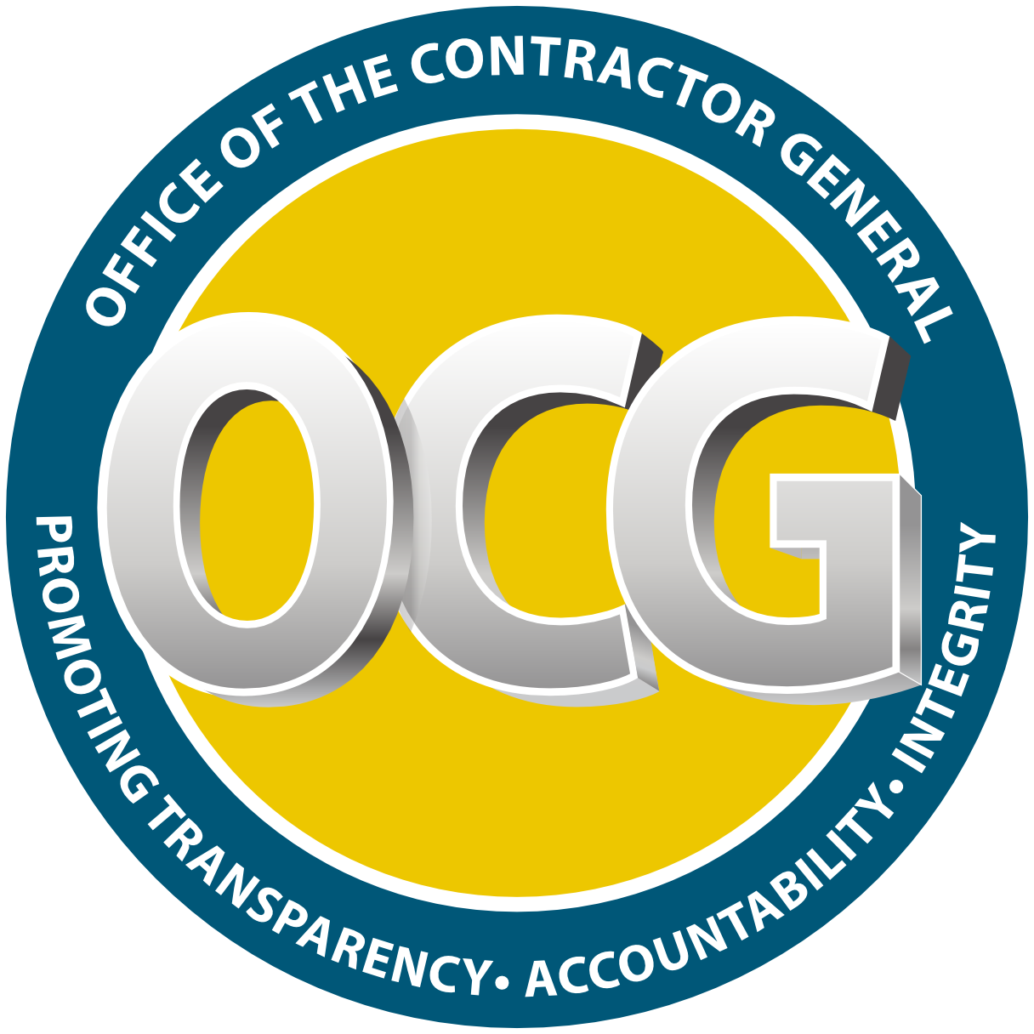

Slide 3
Establishing the Rationale for a Public Procurement Governance System
The Organization for Economic Cooperation and Development (OECD), in its publication entitled “OECD Principles for Integrity in Public Procurement (2009)” puts forward the following:
“From simple mistake to deliberate act: Adapting the response
Government contracts can give rise to mistakes, anomalies, fraud, and misappropriation of public funds or instances of corruption. Some of these problems can be avoided through adequate guidance for public procurement officials.”
- http://www.oecd.org/gov/ethics/48994520.pdf

Slide 4
Fundamentals of a Public Procurement System
“Implementing an effective public procurement system based on transparency, competition and integrity is not simple. A procurement system that lacks transparency and competition is the ideal breeding ground for corrupt behaviour and thus most important international codes on anti-corruption and public procurement rest heavily upon these fundamental principles, in order to discourage corruption.”
-United Nations Office on Drugs and Crime - Guidebook on anti- corruption in public procurement and the management of public finances (2013)

Slide 5
Public Procurement Governance: Its Rationale
The economic and financial uncertainties being experienced by countries around the world have underscored the need and importance for prudent financial management in both the public and private sector.
In light of this reality, and the need to achieve the goals of sustainable development, lies the importance of public procurement governance and the need for effective and efficient public governance institutions.

Slide 6
Public Procurement Governance Rationale (Continued)
In regard to the importance of public procurement, the World Bank in its 2016 publication on “BENCHMARKING PUBLIC PROCUREMENT” acknowledges that public procurement:
“is a critical element of good governance and it plays a fundamental role in achieving the twin goals of ending poverty and building shared prosperity” (World Bank, 2016).

Slide 7
Public Procurement Governance Rationale (Continued)
The World Bank continues to note that the public procurement market is massive and I am sure that you would agree that this market is rapidly increasing.
This phenomenon is primarily as a result of the increasing marketization of government operations in countries around the world.
In developing economies, governments spend an estimated US$820 billion a year, about 50 percent of their budgets, on procuring goods and services (World Bank, 2016). This is an amorous portion of their budgets.

Slide 8
With respect to Jamaica, the table which follows illustrates the value of contracts above $500,000.00, for the respective years.
As we move towards the table, consideration must be given to the size of Jamaica’s budget for the last two years:
2016/2017 Estimates of Expenditure – J$579 Billion
2015/2016 Estimates of Expenditure – J$641 Billion

Slide 9
Reported Value of Contracts Above J$500,000
Reporting Period | Total Number of contracts awarded | Total Value of contracts awarded (JA$) | Total Value of contracts awarded (US$)
2009 | 11,256 | $15,508,086,974.00 | $175,252,423.71
2010 | 10,455 | $14,307,249,677.00 | $163,735,977.08
2011 | 11,152 | $16,143,777,148.00 | $187,543,879.51
2012 | 9,399 | $25,752,214,653.20 | $289,383,241.41
2013 | 8,622 | $45,445,481,023.75 | $450,982,246.94
2014 | 8580 | $58,885,410,309.95 | $515,363,296.95
2015 | 10212 | $101,797,356,613.85 | $846,547,664.1

Slide 10
Public Procurement Governance Rationale (Continued)
Given this level of government spending, it is evident that public procurement is in fact a key variable in determining development outcomes in all areas of public governance. PUBLIC PROCUREMENT IS SERIOUS BUSINESS.
As a result, the World Bank states that when public procurement is carried out in an efficient and transparent manner, it can play a strategic role in delivering more effective public services (World Bank, 2016).

Slide 11
Public Procurement Governance Rationale (Continued)
Public procurement when carried out in an efficient manner is no doubt the most effective governmental operational and strategic policy option to achieve fiscal and monetary policy sustainability.
On the contrary, if public procurement is not carried out in an equitable manner, the results may well be: economic, social, environmental and political instabilities.

Slide 12
Public Procurement Governance Rationale (Continued)
Efficient public procurement also act as a powerful tool for development with profoundly positive repercussions for both good governance and more rapid and inclusive growth (World Bank, 2016).
With regard to Jamaica’s public procurement governance system, the Office of the Contractor (OCG) plays a very integral role in the monitoring of government contracts and the conduct of investigations in instances where irregularities have either been committed or alleged to have been committed.

Slide 13
Changes coming
Plans to separate the National Contracts Commission (NCC) from the operational ambit of the OCG are also said to be well advanced.
In respect to the proposed legislative changes to the OCG Act, there are many uncertainties relating to the specific operational and management model which will be adopted. This reality underscores the need for greater collaboration with all stakeholders in the public governance system.

Slide 14
In terms of Jamaica’s public procurement legislative framework, The Contractor General Act is the principal Legislation, which governs the procurement administration of government contracts.
However, Parliamentary deliberations are being advanced to facilitate changes to the referenced Act in order to facilitate a single anti-corruption agency. As a signatory to The United Nations Convention Against Corruption, Jamaica is obliged to uphold the principles thereof, and in this regard, it is necessary for us to be reminted of the legislative and policy advise given in Article (9) of the UNCAC:

Slide 15
UNCAC - Article 9: Public Procurement and Management of Public Finances
Each State Party shall, in accordance with the fundamental principles of its legal system, take the necessary steps to establish appropriate systems of procurement, based on transparency, competition and objective criteria in decision-making, that are effective, inter alia, in preventing corruption (UNCAC, Article 9).
Article 9 (d) admonishes us to ensure “An effective system of domestic review, including an effective system of appeal, to ensure legal recourse and remedies in the event that the rules or procedures … established are not followed.”

Slide 16
Public Procurement Governance Rationale (continued)
There is in fact a intricate link between public procurement and a country’s social, economic, political and environmental well-being.
Hence, the public procurement system must be governed by integrity, transparency, competition, accountability and value for money in all areas of public financial management. This emphasizes the need for continuous anti-corruption risk assessment in order to ensure that adverse risks are identified and addressed.

Slide 17
Underscoring the Importance of Transparency & Accountability in PP Systems
As earlier indicated, and acknowledged by the World Bank, the public procurement market is massive. This reality presents numerous challenges and opportunities for government actors and other stakeholders.
On the adverse side of this reality, is the increasing risk of the perpetuation of acts of corruption and irregularities.

Slide 18
Transparency & Public Procurement Systems
It is also necessary at this jucture, to further highlight the importance of transparency and accountability in the public procurement process. These elements are key fundamentals of an efficient public procurement governance.
Therefore, as far as, is administratively and legislatively possible, public procurement should to the greatest extent be transparent in its practices, processes, policies and relationships with all stakeholders, while ensuring protection of confidential information.

Slide 19
In realization of the size and scope of government spending activity, it is critical that all stakeholders have confidence in the public procurement process and this can only be attained via transparent processes (Adapted from NIGP. (2010). Transparency in Government procurement. Herndon, VA: NIGP)
Transparency and accountability in public procurement is also an effective tool that has the potential to gain the trust and confidence of citizens.

Slide 20
Transparency and PP Systems (continued)
A transparent and informative public procurement process with standardized processes and the simplification of access to information makes doing business with government much more appealing to the supplier community and strengthens the public’s trust. The Internet has provided us with numerous opportunities which are capable of enhancing transparency in this regard.
For example: since the adoption of the OCG’s Quarterly Contract Awards on-line reporting system, the Office has received a 100% compliance rate from public entities in recent years. This is reflected in the following table:

Slide 21
QCA Reporting Results

Slide 22
Accountability & Public Procurement Systems
According to the UNDP (2008):
“accountability constitutes a central pillar of any public procurement system. Without accountable systems enabling governments and citizens to engage in a mutually responsive way, the vast resources channelled through public procurement systems run the danger of increased corruption and misuse of funds.”

Slide 23
As we reflect on the constant need for greater accountability in the public procurement process, it is of utmost importance for us to understand that the administration of a public procurement system is not a single agency mandate.
All stakeholders must play a key role in the process. The Parliament and its relevant Commissions/Committees must be actively involved in the process, with one single aim, that is, to ensure prudent financial management and the attainment of good governance.

Slide 24
As it relates to the Cabinet, outside of the Parliament, the Cabinet is the principal decision making agency within our political system framework. Given the responsibility conferred upon Cabinet Ministers, it beholds all Ministers to ensure that the decisions that are made are in the best interest of the country.
Decisions should not be contrary to the public’s interest. For example the Cabinet should not be signing off on, and/or granting permits or licenses to entities or individuals who have not demonstrated due care. The Mobile Spectrum Licence issued to Symbiote Investments Limited t/a Caricel is a typical example.

Slide 25
Importantly, countries capable of controlling corruption in the public procurement sector are able to use their human and financial resources more efficiently, attract more foreign and domestic investment, and an average grow more rapidly.

Slide 26
Recommendations
Intensify the use of information technology strategies in a bid to promote transparency in public procurement administration.
Ensure the effectiveness of public financial management and public procurement oversight bodies.
Promote and legislate ethical standards, where possible in the management of all areas of public financial management.

Slide 27
Recommendations (continued)
Continued education and development of procurement and other financial management staff.
Ensure effective penalties for those who breach procurement rules and regulations.
Ensure continued anti-corruption risk assessments for government ministries, agencies and departments.

Slide 28
Recommendations (continued)
Implement and enforce a corporate governance framework which is steeped in operational principles and practices, which enforce accountability and adherence to rules and regulations.
The inclusion of civil society in the public procurement governance system should be encouraged in order to increase transparency and accountability.

Slide 29
References
World Bank (2016) Benchmarking Public Procurement 2016 Assessing Public Procurement Systems in 77 Economies, retrieved on November 7, 2016 from: http://bpp.worldbank.org/~/mediadocuments/Reports/Benchmarking-Public-Procurement-2016.pdf
United Nations Office on Drugs and Crime-Guidebook on anti-corruption in public procurement and the management of public finances (2013)

Slide 30
THANK YOU
QUESTIONS AND ANSWERS

